Slide 1
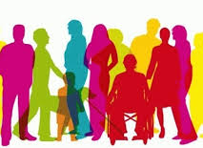
Diversity and Inclusion

Slide 2
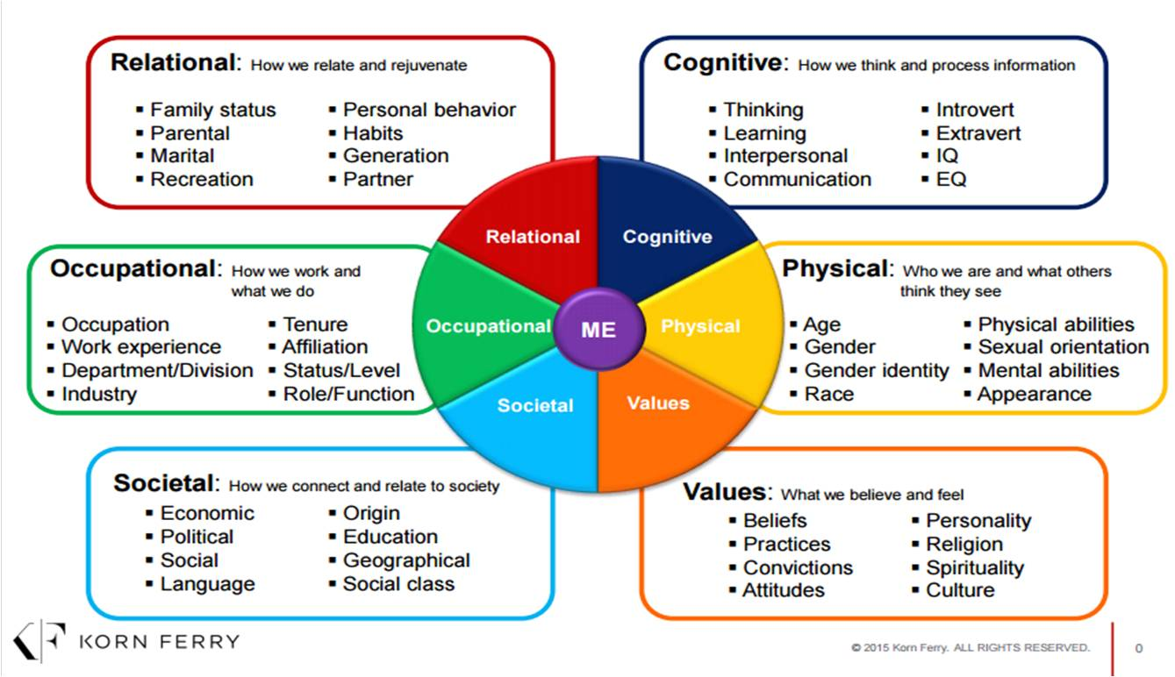
Identity Wheel
Each person carries an intersection of identities with them
Notes:
People have many components of their identity, each of them bringing something different to the table.
Diversity can encompass some of the more visible aspects of identity, but it also encompasses the abstract or invisible aspects that we talk about less often.
We all are considered diverse because of this. No one should feel left out from the conversation and not all conversations surrounding Diversity and Inclusion have to be indignant.
Understanding ourselves can bring self-awareness and by celebrating each others’ differences we might come to take the perspective of others seriously. In turn, we can make progress on some of the pain points our society faces around Diversity and Inclusion

Slide 3
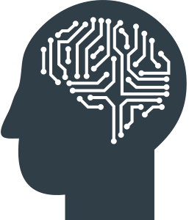
Why is Bias, At Times, Unconscious?
Human beings are wired to see patterns as a survival tool
We all have shortcuts, “schemas” that help us make sense of the world. But our shortcuts sometimes make us misinterpret things. That’s unconscious bias
Notes:
Biases are basically shortcuts. We have been genetically wired to use shortcuts in order to survive and thrive as a species
It becomes problematic when we incorrectly conclude something based on these shortcuts or when we categorize humans based on identity (which we can agree is individual!)
Unconscious Bias is, well, unconscious

Slide 4
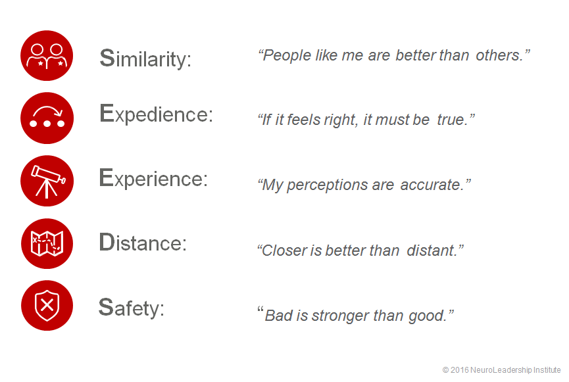
The SEEDS ® Model of Bias
Unpacking the different types of biases helps mitigate against them

Slide 5
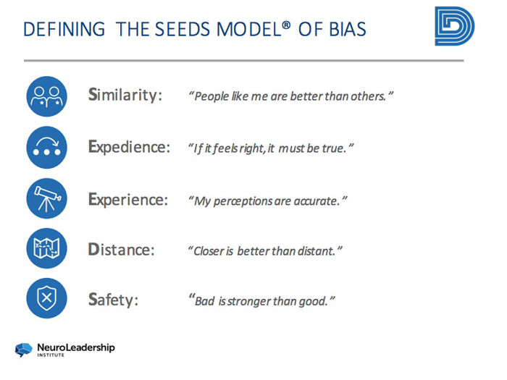
The SEEDS ® Model of Bias
Unpacking the different types of biases helps mitigate against them

Slide 6
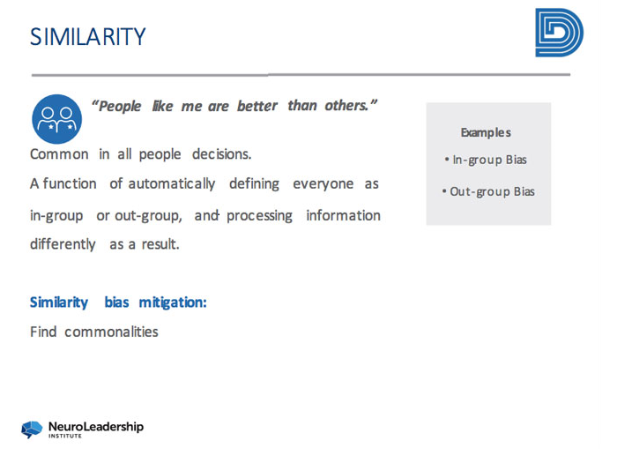
The SEEDS ® Model of Bias
Unpacking the different types of biases helps mitigate against them

Slide 7
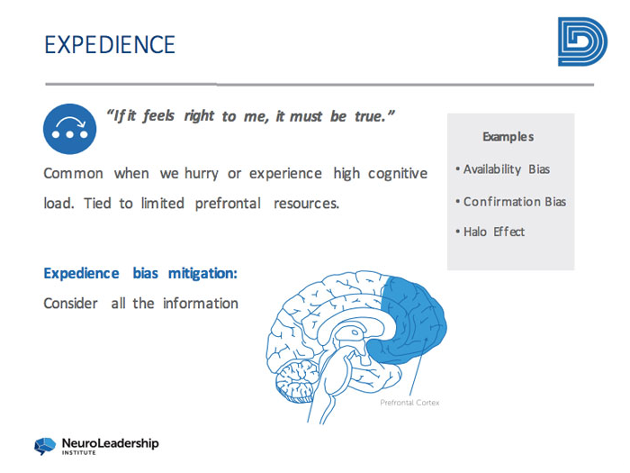
The SEEDS ® Model of Bias
Unpacking the different types of biases helps mitigate against them

Slide 8
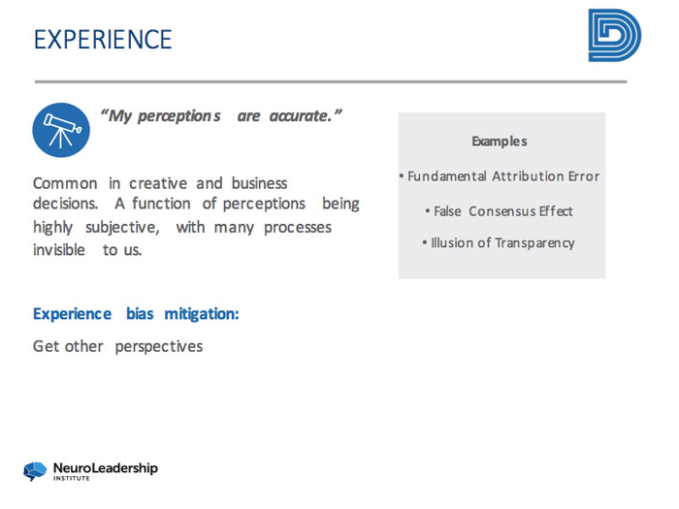
The SEEDS ® Model of Bias
Unpacking the different types of biases helps mitigate against them

Slide 9
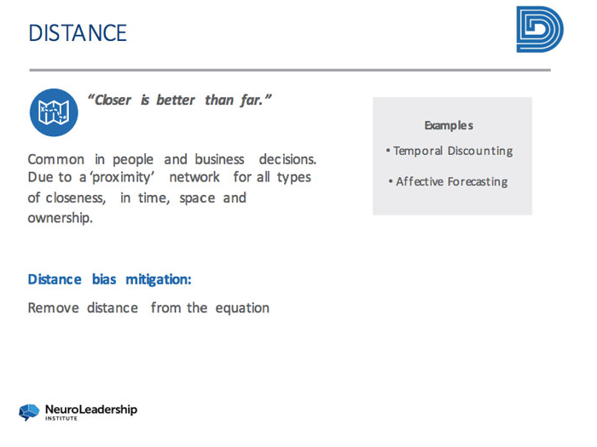
The SEEDS ® Model of Bias
Unpacking the different types of biases helps mitigate against them

Slide 10
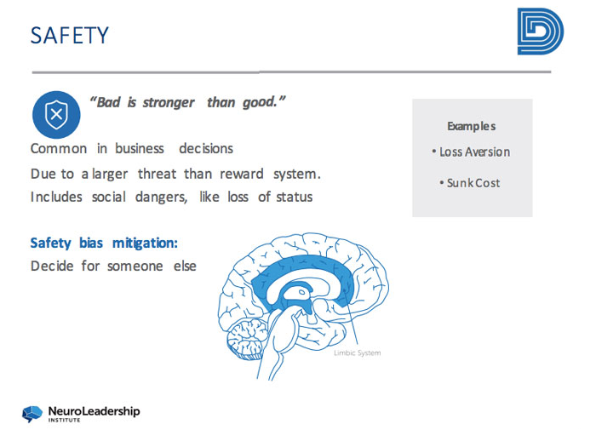
The SEEDS ® Model of Bias
Unpacking the different types of biases helps mitigate against them

Slide 11
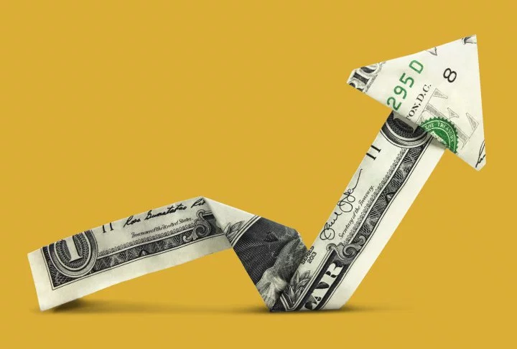
Business Case for Diversity & Inclusion Focus
We Must Evolve to Leverage Diversity in Our Business Strategy
McKinsey Articles:
2015 Report
https://www.mckinsey.com/business-functions/organization/our-insights/why-diversity-matters
2018 Report
https://www.mckinsey.com/business-functions/organization/our-insights/delivering-through-diversity

Slide 12
